Slide 1
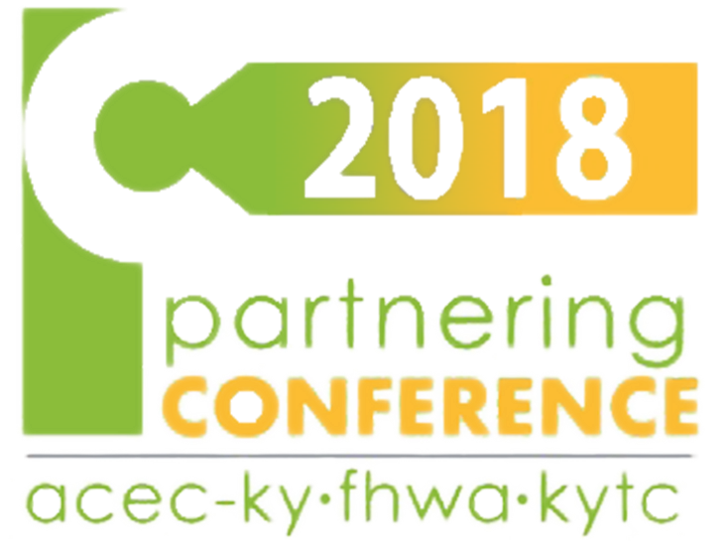
Utility Coordination: Lessons Learned
11-188 US25E Widening & Access Management

Slide 2
Project Map
Notice to proceed given to ATS Construction 7/25/18.
Notes:
Project on US25E in Corbin in Knox County to improve access management. Involved removing/relocating traffic signals, adding or improving frontage roads.
Corbin/I-75 to the left, Barbourville to the right. 4 signals in 0.4 miles; reduced to 3. 34 access points reduced to 32, some right in-right out. 18 median crossovers reduced to 13, some left turn only.

Slide 3
Large Utility Involvement
3 Municipal Utilities
2 Electric Companies
2 Phone Companies
CATV
Natural Gas
The average project in our district will only have 1 of each, and may not include a gas company.
Notes:
Project included many more companies than are usually involved.

Slide 4
Work Done By Cabinet
The 3 municipal utilities affected by the project were approached in the early stages about allowing relocation design to be done by the Cabinet’s highway design consultant & the relocation to be done as part of the highway contract.
This allows for conflicts to be addressed by a single entity rather than trying to coordinate with multiple designers.
Relocation in the highway contract removes the work from the preconstruction schedule & removes uncertainty about the exact location of relocated facilities.
Notes:
Barbourville & Corbin Utilities receptive to allowing the Cabinet to handle their relocations. Laurel Water District #2 preferred a traditional approach. LWD did not complete relocation before letting.

Slide 5
Relocation By Highway Contractor
Utility can include a list of at least 3 approved contractors to do their relocation work.
This allows the utility to be more restrictive on who does the work than can normally be achieved by open bidding.
Cabinet is providing an inspector to monitor the relocation work, but the Utility can still have their own inspector on site as well.
Element of risk of not having utilities clear by letting date is eliminated.
Unforeseen conflicts can be better handled when contractor responsible for the roadwork is also responsible for the utilities.
Notes:
General comments on having relocation work done in the Cabinet’s highway contract

Slide 6
Design Conflicts
Corbin Utilities has a large amount of facilities in a congested area.
Proposed facilities:
Nearly 5,000’ of waterline
2,000’ of force main, 3,500’ of gravity sewer, & 27 manholes
Having the utilities designed by the highway designer allows for conflicts with the roadwork to be addressed more quickly & efficiently than if everything has to move through an intermediary.
Notes:
About 10,000’ of water & sewer lines vying for space with ditches & storm sewer pipe.
Also decreases the chance of a conflict being overlooked.

Slide 7
Avoidance
Barbourville Utilities 18” ductile iron raw water line
Carries water from Laurel River Lake to a treatment plant in Barbourville (~20 miles).
Existing line runs the length of the project (~2 miles) in the eastbound shoulder.
Originally proposed to relocate almost the entire length of line located in the project at an estimated cost of nearly $2 million.
Utility was concerned about piecemeal relocation causing extended downtime. Line would need to be flushed each time to remove air & debris before normal service could begin.
Notes:
Barbourville Utilities’ large DI line presented the most significant single item cost.

Slide 8
Modified shoulder to largely avoid disturbing the line.
BUC & the Cabinet’s consultant excavated key locations to determine exact location & depth.
Final decision was to leave the existing line in place & install 470’ of split encasement across 5 proposed entrances at a cost of $223,250.
Notes were included in the highway contract to minimize the amount of time the line will be taken out of service for minimal disruption to Barbourville’s pumping operations.
Notes:
Line could be mostly avoided by modifying shoulder work, resulting in a substantial cost savings.

Slide 9
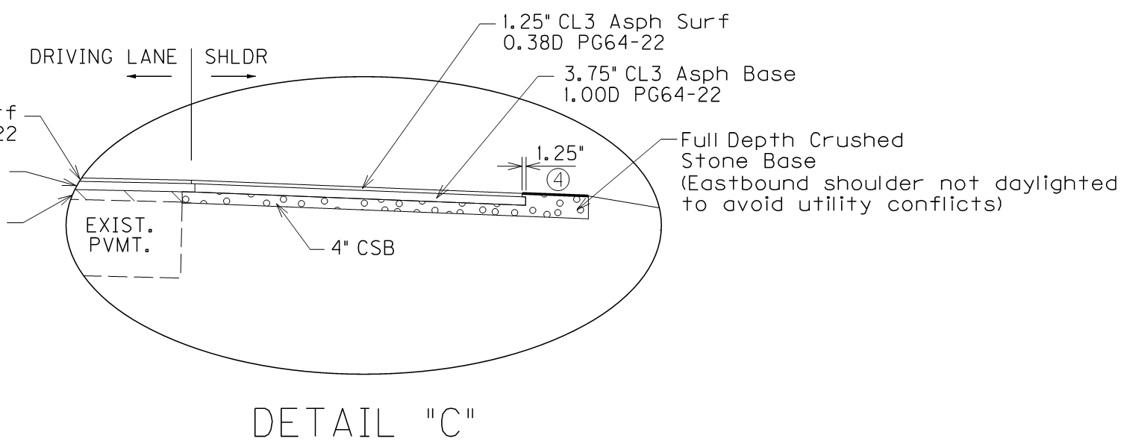
Notes:
Typical section & plan notes.
Perforated pipe was added where needed to allow for drainage once the decision was made to not daylight the shoulder.

Slide 10
Due to acidic nature of the soil & age of the line, pitting is an issue in certain areas. This could make exposing & encasing the line difficult.
The split encasement bid price came in above what was estimated.
During the preconstruction meeting, ATS agreed to an onsite meeting with Barbourville Utilities to investigate the areas to be encased.
If the condition of the line was such that it would be more economical to replace & traditionally encase, Barbourville would consider that option.
Notes:
Highway contractor & his sub contractor open to working with the utility to get the best product.

Slide 11
ROW Coordination
Near the beginning of the project there is a privately owned 4” sanitary sewer force main which feeds into an 8” line owned by Corbin City Utilities.
This line was not differentiated on plans from any other. It was the right of way staff which initially brought to our attention that this line was privately owned & potentially impacted by the project.
Due to the uncertainty of impacts & tight schedule, the decision was made to leave most of the existing line in place. Sections that would be affected were to be replaced & encased by the highway contractor.
Notes:
Departments often worry about stepping on each others’ toes. Some separation prevents having too many cooks; too much separation can lead to overlooked details.
Options were to pay the property owner for the impact or relocate with the highway contract.

Slide 12
Betterment
LWD#2 initially proposed relocation of 5,300’ of 6” line.
It was the opinion of the District that the existing line could be avoided & left in place in several locations.
Ground penetrating radar & vacuum excavation were utilized with varying degrees of success to find the existing lines.
The Water District followed up by using company personnel to excavate the line. KYTC surveyors were on hand to take shots on the line.
Notes:
It is often the utilities’ preference that all line in the area be relocated, regardless of level of impact. Statewide SUE services were called on to locate the existing line.

Slide 13
Water District consultant claimed line could not be left in place due to only having ~20” of cover.

Slide 14
After these locations were obtained, we were able to negotiate with the Water District to leave some sections in place, with a final count of 3,180’ of 6” line to be relocated.
The changes resulted in a savings of approximately $125,000.

Slide 15
Lessons Learned
Need for standardized utility design units for use in scoping.
Internal coordination is vital, especially on a project of this magnitude.
Relocation plans designed by same company, but not necessarily by the same people.
Deadlines, scope of work, & other important information conveyed to the roadway design team did not make it to the utility designers in a timely fashion. This led to last minute corrections, plan changes, & construction change orders.
Cabinet’s consultant is put in the middle of conflicting interests.
Consultant is working for the Cabinet, but is being asked to be an advocate for both the Cabinet & the utility (see the previous Betterment slide).
Notes:
Utility design is estimated differently in the Cabinet’s design process than it is in the utility coordination process.
ROW coordination is vital in order to get useful information from property owners as well as for clearing priority parcels for utility companies.
By having the relocation design done by the roadway consultant we had hoped to avoid last minute changes that can be common when working with utility consultants.

Slide 16
Herding Cats
Expectation was to save time & money by having the highway consultant design the utility relocation. The jury is out on the full scope of achieved benefits. The project went better than it could have had we not taken steps for early coordination & increased Cabinet involvement, but was not without challenges.
We are taking the lessons learned from this project forward to the next section of this roadway.
The search continues for the perfect execution of the cat herding process that is utility relocation.

Slide 17
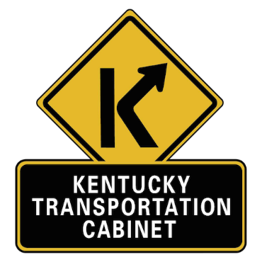
Thanks!
Keenan Jones, PE
KYTC District 11 Utilities
Sherri Chappell, PE
KYTC Project Manager
Notes:
Questions?

